Slide 1

Exploration

Slide 2

Database
A database is an organized collection of data.
The main purpose of database is to operate large amount of information by storing, retrieving and managing.
There are many dynamic websites on the world wide web nowadays which are handled through databases. For example, a model to checks the availability of rooms in a hotel. It is an example of dynamic website that uses database.

Slide 3
RDBMS
RDBMS (Relational Database Management Systems) is database relational model based, introduced by E.F. Codd (1970s).
In RDBMS, data is represented in terms of tuples (rows). It contains number of tables and each table has its own primary key.
All modern database management systems like SQL, MS SQL Server, IBM DB2, ORACLE, My-SQL and Microsoft Access are based on RDBMS.

Slide 4
SQL
SQL (Structured Query Language) is used to communicate with a database. It’s the standard language for relational database management systems. SQL statements are used to perform tasks such as update data on a database, or retrieve data from a database.
Some common relational database management systems that use SQL are: Oracle, Sybase, Microsoft SQL Server, Access, Ingres, etc.
The standard SQL commands such as "Select", "Insert", "Update", "Delete", "Create", and "Drop" can be used to accomplish almost everything that one needs to do with a database.

Slide 5
MySQL
MySQL is the world's most popular open source database. With its proven performance, reliability and ease-of-use, MySQL has become the leading database choice for web-based applications, used by high profile web properties including Facebook, Twitter, YouTube, Yahoo and many more.
MySQL has been developed by MySQL AB & Oracle Corporation since 23rd May 1995, written in C and C++.

Slide 6
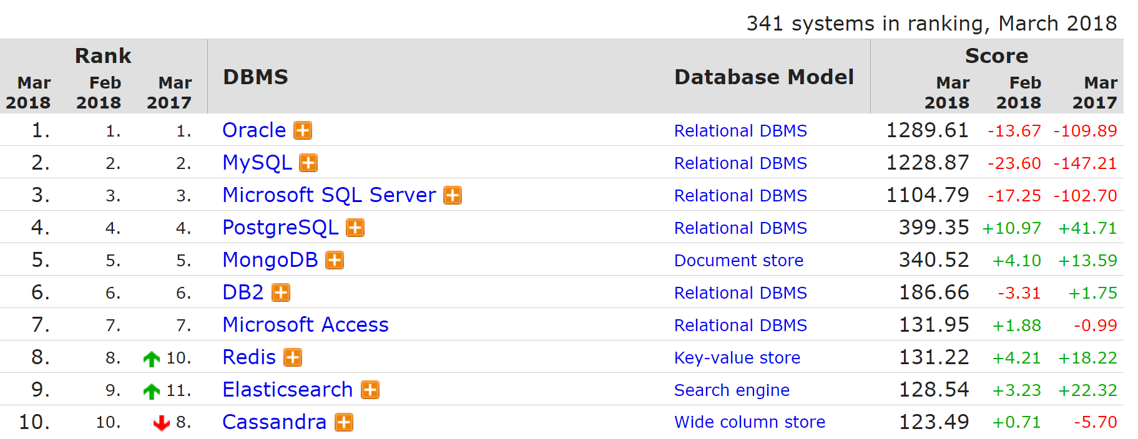
MySQL Ranking
2nd All DB-engines
https://db-engines.com/en/ranking

Slide 7
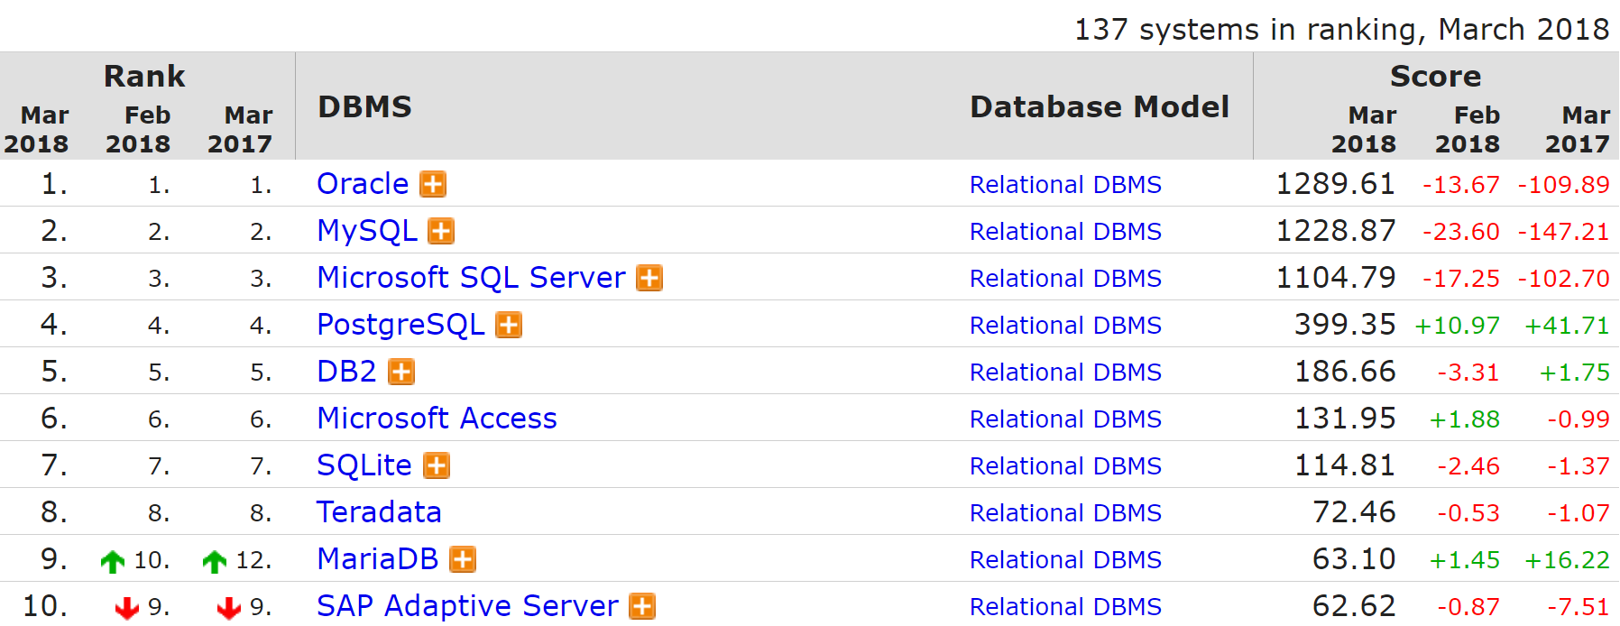
MySQL Ranking
2nd RDBMS DB-engines
https://db-engines.com/en/ranking

Slide 8

Primary Key
The Primary keys constraint uniquely identifies each record in a database table.
Primary keys must contain UNIQUE values, and cannot contain NULL values.
A table can have only one primary key, which may consist of single or multiple fields.
Example: No_KTP, product_key, ID_sidikjari

Slide 9
Composite Key
A composite key is a combination of two or more columns in a table that can be used to uniquely identify each row in the table when the columns are combined uniqueness is guaranteed, but when it taken individually it does not guarantee uniqueness.
Columns that make up the composite key can be of different data types.
Example: nama & tglLahir, ID_prod & prod_date

Slide 10
Foreign Key
A foreign key is a field or a column that is used to establish a link between two tables. In simple words you can say that, a foreign key in one table used to point primary key in another table.

Slide 11
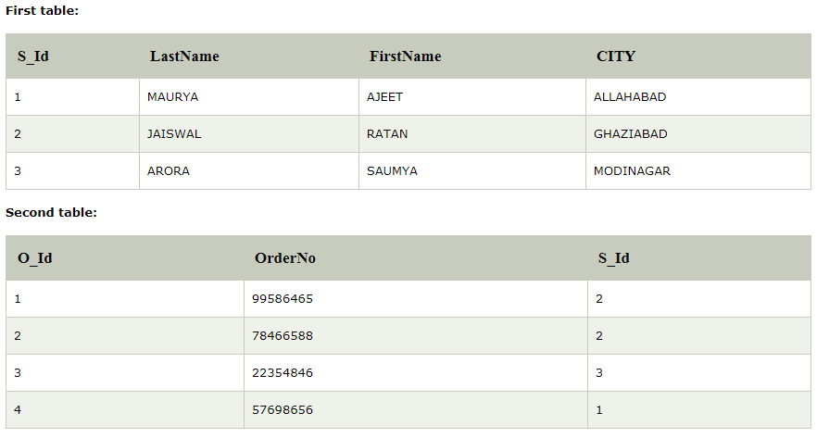
Foreign Key
The "S_Id" column in the 1st table is the PRIMARY KEY in the 1st table.
The "S_Id" column in the 2nd table is a FOREIGN KEY in the 2nd table.

Slide 12

Getting Started
Download & install MySQL
from its official site or XAMPP!
MySQL Installer
www.mysql.com/
downloads/
On Windows, it needs
.NET Framework
www.microsoft.com/net/
download/windows
XAMPP Bundle
apachefriends.org

Slide 13
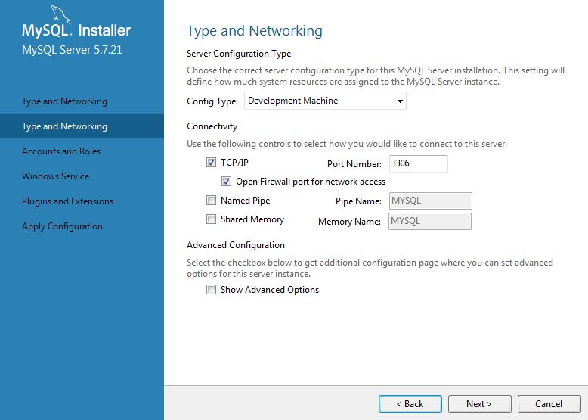
#1 With MySQL Installer
Installation: Server Config

Slide 14
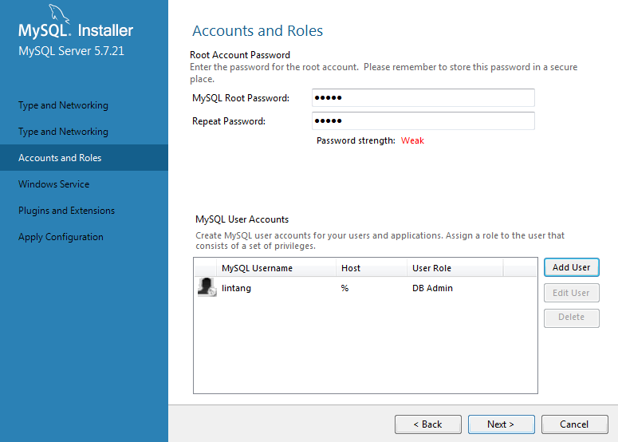
#1 With MySQL Installer
Installation: Accounts & Roles

Slide 15

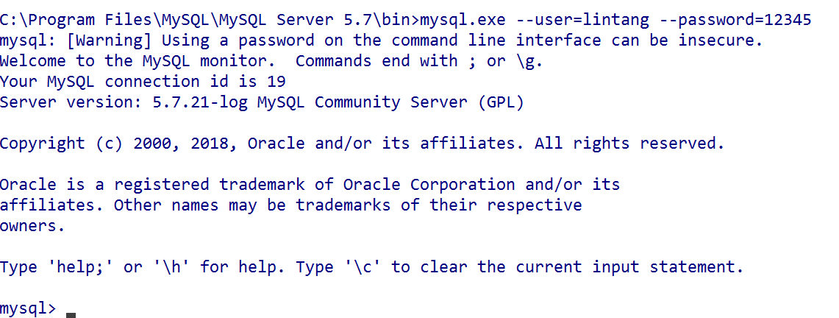
#1 With MySQL Installer
Setup Database Server
Via Command Prompt, go to mysql.exe directory
C:\Program Files\MySQL\MySQL Server 5.7\bin
then execute:
$ mysql.exe --user=root --password=12345
or
$ mysql.exe -u lintang -p12345

Slide 16
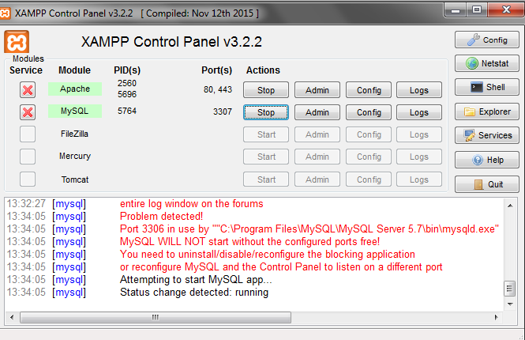
#2 With XAMPP
Activate Apache & MySQL Server

Slide 17
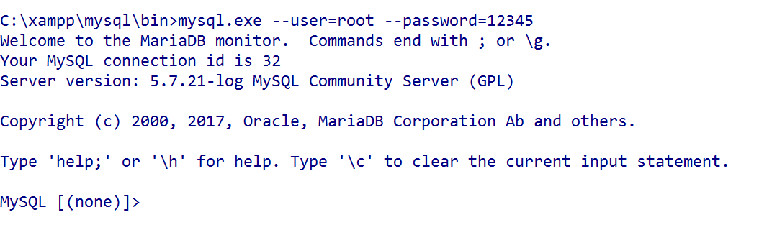
#2 With XAMPP
Setup Database Server
Via Command Prompt, go to mysql.exe directory
C:\xampp\mysql\bin then execute:
$ mysql.exe --user=root --password=12345
or
$ mysql.exe --user=lintang --password=12345

Slide 18


?
How to Work
With MySQL
Database

Slide 19
Create Database
Menampilkan daftar database yang ada:
$ SHOW databases;
Membuat database bernama “toko”:
$ CREATE database toko;
$ CREATE database IF NOT EXISTS toko;
Menghapus database “toko”:
$ DROP database toko;

Slide 20
Create Table
Menggunakan/mengaktifkan database “toko”:
$ USE toko;
Menampilkan tabel dalam database “toko”:
$ SHOW tables;
$ SHOW FULL tables;
Membuat tabel “tes” berisi 1 kolom “NoID”:
$ CREATE TABLE tes (NoID INT);
Lihat struktur tabel “tes”:
$ DESCRIBE tes;
Hapus tabel “tes”:
$ DROP TABLE tes;

Slide 21
Create Table
$ CREATE TABLE karyawan (
-> No INT NOT NULL AUTO_INCREMENT,
-> Nama VARCHAR(30) NOT NULL,
-> Usia TINYINT,
-> Berat FLOAT(3,1),
-> Kota TEXT,
-> Th YEAR,
-> Data_In TIMESTAMP,
-> PRIMARY KEY (No)
-> );

Slide 22
Insert Data
$ INSERT INTO karyawan VALUES(
-> NULL,
-> ‘Andi Santosa’,
-> 42,
-> 78.2,
-> ‘Jakarta’,
-> 2001,
-> NULL
-> );
Lihat semua data pada tabel karyawan:
$ SELECT * FROM karyawan;

Slide 23
* Additional Query *
Create Table
$ CREATE TABLE tim_sales (
-> No INT NOT NULL AUTO_INCREMENT,
-> Nama VARCHAR(30) NOT NULL,
-> Usia SMALLINT,
-> Sex SET(‘Pria’,’Wanita’),
-> Area ENUM(‘Jkt’,’Bdg’,’Sby’),
-> Kode VARCHAR(8) NOT NULL UNIQUE,
-> Gaji INT DEFAULT 3000000,
-> PRIMARY KEY (No)
-> );
//coba insert data

Slide 24
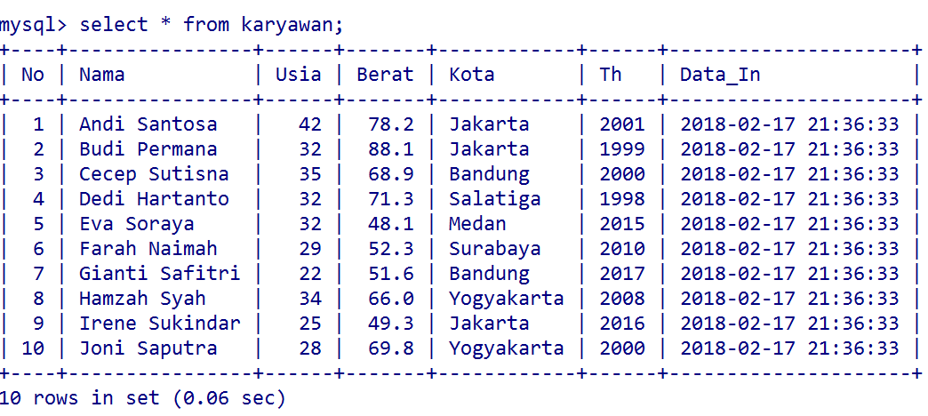
Insert Data

Slide 25
Insert Multiple Data
$ INSERT INTO karyawan VALUES
(NULL,'Andi Santosa',42,78.2,'Jakarta',2001,NULL),
(NULL,'Budi Permana',32,88.1,'Jakarta',1999,NULL),
(NULL,'Cecep Sutisna',35,68.9,'Bandung',2000,NULL),
(NULL,'Dedi Hartanto',32,71.3,'Salatiga',1998,NULL),
(NULL,'Eva Soraya',32,48.1,'Medan',2015,NULL),
(NULL,'Farah Naimah',29,52.3,'Surabaya',2010,NULL),
(NULL,'Gianti Safitri',22,51.6,'Bandung',2017,NULL),
(NULL,'Hamzah Syah',34,66.0,'Yogyakarta',2008,NULL),
(NULL,'Irene Sukindar',25,49.3,'Jakarta',2016,NULL),
(NULL,'Joni Saputra',28,69.8,'Yogyakarta',2000,NULL)
;

Slide 26
Insert Data
Pada tabel “karyawan” di database “toko”,
Insert data hanya ke kolom Nama & Usia:
$ INSERT INTO karyawan (Nama, Usia) VALUES
-> (‘Budi Raharja’, 52);
Insert multiple data ke kolom Nama:
$ INSERT INTO karyawan (Nama) VALUES
-> (‘Caca’),(‘Dedi’);

Slide 27
Update Data
Update data untuk semua isi kolom tertentu:
$ UPDATE karyawan SET Th = 2010;
Update data untuk baris data tertentu:
$ UPDATE karyawan SET Nama = “Anisa Safitri”
-> WHERE No = 1;
$ UPDATE karyawan SET
Nama = “Anisa Safitri”, Usia = 28,
Kota = “Medan”, Job = “Programmer”
-> WHERE No = 1;

Slide 28
Delete Data
Delete semua data pada tabel:
$ DELETE FROM karyawan;
Delete baris data tertentu di tabel:
$ DELETE FROM karyawan
-> WHERE No = 4;

Slide 29
Insert Column
Lihat struktur tabel
$ DESCRIBE karyawan;
Add kolom Gaji:
$ ALTER TABLE karyawan
-> ADD COLUMN Gaji INT;
Add kolom Gaji setelah kolom Tahun:
$ ALTER TABLE karyawan
-> ADD COLUMN Gaji INT AFTER Th;
Hapus kolom:
$ ALTER TABLE karyawan
-> DROP COLUMN Gaji;

Slide 30
Select
Lihat semua isi data pada tabel:
$ SELECT * FROM karyawan;
Lihat data pada atribut/kolom tertentu:
$ SELECT Nama, Kota FROM karyawan;
Lihat 5 data pertama:
$ SELECT * FROM karyawan LIMIT 5;
Lihat 5 data setelah data ke-3:
$ SELECT * FROM karyawan LIMIT 3,5;

Slide 31
Select
Lihat additional data di luar tabel.
*Tampilkan setengah Berat Badan:
$ SELECT Nama, Berat,
-> 0.5 * Berat AS separoBB
-> FROM karyawan;
*Berapa tahun lagi waktu pensiun:
$ SELECT Nama, Usia,
-> 55 – Usia AS jarakPensiun
-> FROM karyawan;

Slide 32
Order By
*Urutkan Nama berdasarkan Usia:
$ SELECT Nama, Usia
-> FROM karyawan ORDER BY Usia;
*Urutan Descending Nama berdasar Usia:
$ SELECT Nama, Usia
-> FROM karyawan ORDER BY Usia DESC;
*Urutkan Nama berdasarkan Usia lalu Berat:
$ SELECT Nama, Usia, Berat
-> FROM karyawan ORDER BY Usia, Berat;

Slide 33
Order By Field
*Urutkan Nama & kelompokkan Nama
berdasarkan urutan Kota:
$ SELECT Nama, Kota
-> FROM karyawan ORDER BY FIELD(Kota,
-> ‘Jakarta’,’Yogyakarta’,’Bandung’,
-> ‘Salatiga’,’Medan’,’Surabaya’);
$ SELECT Nama, Kota
-> FROM karyawan ORDER BY FIELD(Kota,
-> ‘Jakarta’,’Yogyakarta’,’Bandung’,
-> ‘Salatiga’,’Medan’,’Surabaya’)
-> DESC;

Slide 34
Where
$ SELECT * FROM karyawan
-> WHERE No > 2;
$ SELECT * FROM karyawan
-> WHERE Berat BETWEEN 45 AND 55;
$ SELECT Nama FROM karyawan
-> WHERE Usia < 25 OR Th > 2016;
$ SELECT Nama FROM karyawan
-> WHERE Th IN (2010,2017);

Slide 35
Where Like
$ SELECT Nama FROM karyawan
-> WHERE Nama LIKE ‘a%’;
$ SELECT Nama FROM karyawan
-> WHERE Nama LIKE ‘%na’;
$ SELECT Nama FROM karyawan
-> WHERE Nama LIKE ‘%di%’;
$ SELECT Nama FROM karyawan
-> WHERE Nama NOT LIKE ‘%di%’;

Slide 36
Count, Min & Max
$ SELECT COUNT(*) FROM karyawan
-> WHERE Kota = ‘Jakarta’;
$ SELECT COUNT(*) AS Banyaknya
-> FROM karyawan
-> WHERE Kota = ‘Jakarta’;
$ SELECT MIN(Usia) AS Termuda
-> FROM karyawan;
$ SELECT MAX(Usia) AS Tertua
-> FROM karyawan;

Slide 37
Sum & Avg
$ SELECT SUM(Usia) FROM karyawan
-> WHERE Kota = ‘Yogyakarta’;
$ SELECT SUM(Usia) AS Total_Usia
-> FROM karyawan
-> WHERE Kota = ‘Yogyakarta’;
$ SELECT AVG(Usia) AS Rata_Usia
-> FROM karyawan
-> WHERE Kota = ‘Yogyakarta’;

Slide 38
Group By
Hitung banyaknya karyawan di tiap kota:
$ SELECT Kota, COUNT(*) AS Karyawan
-> FROM karyawan
-> GROUP BY Kota;
Hitung rerata BB karyawan di tiap kota:
$ SELECT Kota, AVG(Berat) AS Rata_BB
-> FROM karyawan
-> GROUP BY Kota;

Slide 39
Having
Rerata BB karyawan di tiap kota:
$ SELECT Kota, AVG(Berat) AS Rata_BB
-> FROM karyawan
-> GROUP BY Kota;
Tampilkan kota dg rerata BB kary < 65:
$ SELECT Kota, AVG(Berat) AS Rata_BB
-> FROM karyawan
-> GROUP BY Kota
-> HAVING Rata_BB < 65;

Slide 40
Subquery
Query inside query
Menampilkan nama & usia karyawan di
Jakarta, yang usianya > rata-rata usia
karyawan di Yogyakarta:
$ SELECT Nama, Usia FROM karyawan
-> WHERE Kota = ‘Jakarta’ AND Usia > (
-> SELECT AVG(Usia) FROM karyawan
-> WHERE Kota = ‘Yogyakarta’);

Slide 41
Subquery From
Menampilkan rata-rata usia dari:
tabel nama & usia karyawan di Jakarta,
yang usianya > rata-rata usia
karyawan di Yogyakarta:
$ SELECT AVG(Usia) AS Rata_Usia FROM
-> (SELECT Nama, Usia FROM karyawan
-> WHERE Kota = ‘Jakarta’ AND Usia > (
-> SELECT AVG(Usia) FROM karyawan
-> WHERE Kota = ‘Yogyakarta’));

Slide 42
?
How to Work
With MySQL
GUI Tools

Slide 43
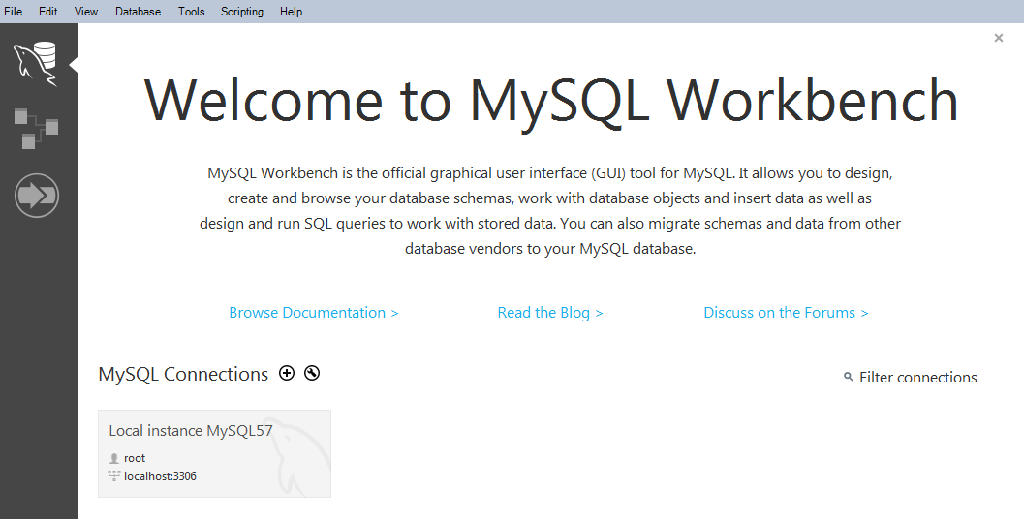
Working with GUI
#1 Installing MySQL Workbench

Slide 44
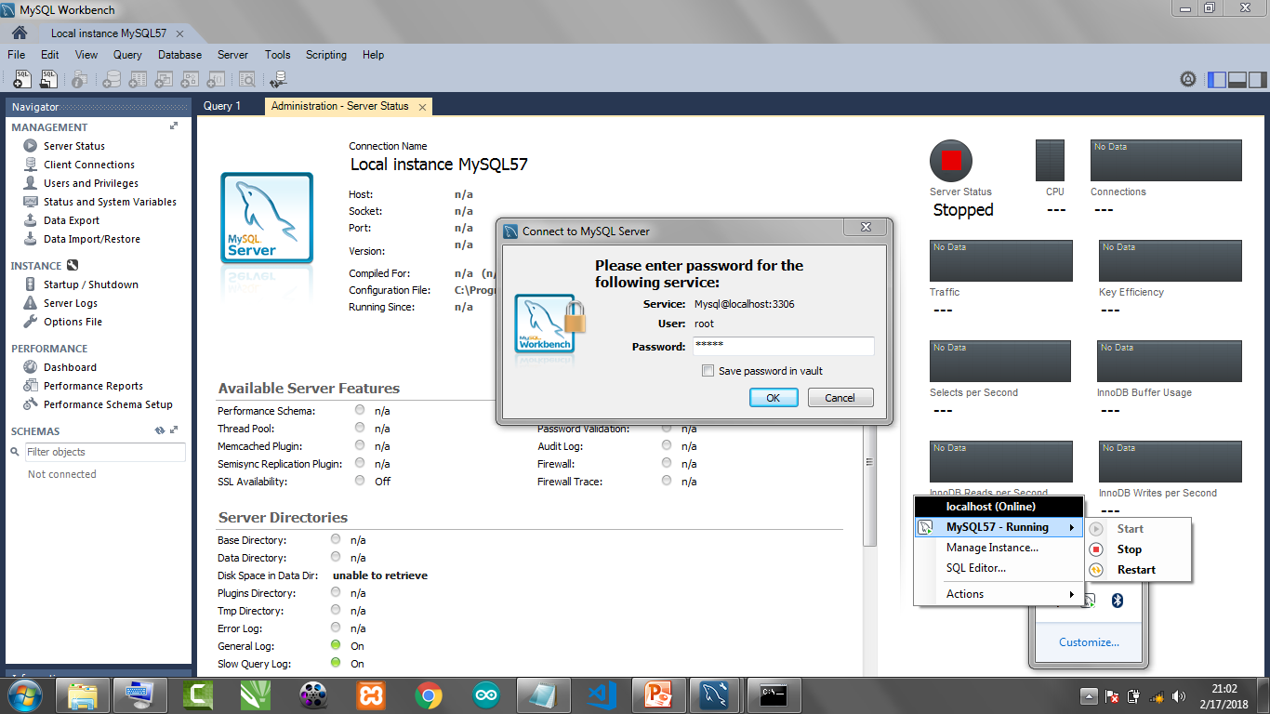
Working with GUI
#2 Activate MySQL & Connect to Workbench

Slide 45
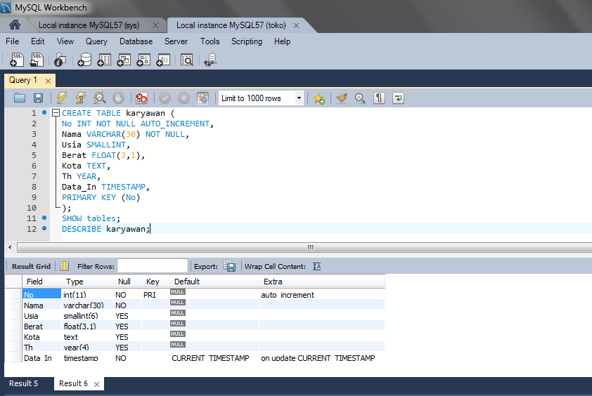
Working with GUI
#3 Happy Querying!
Insert & execute
query here!
Result will be
shown here.

Slide 46
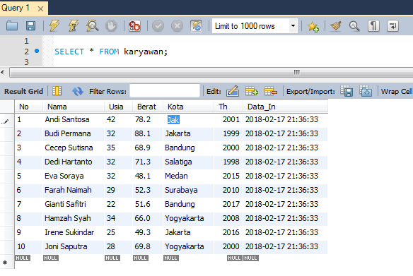
Working with GUI
#4 Easier data processing
Click
Then
Edit!

Slide 47
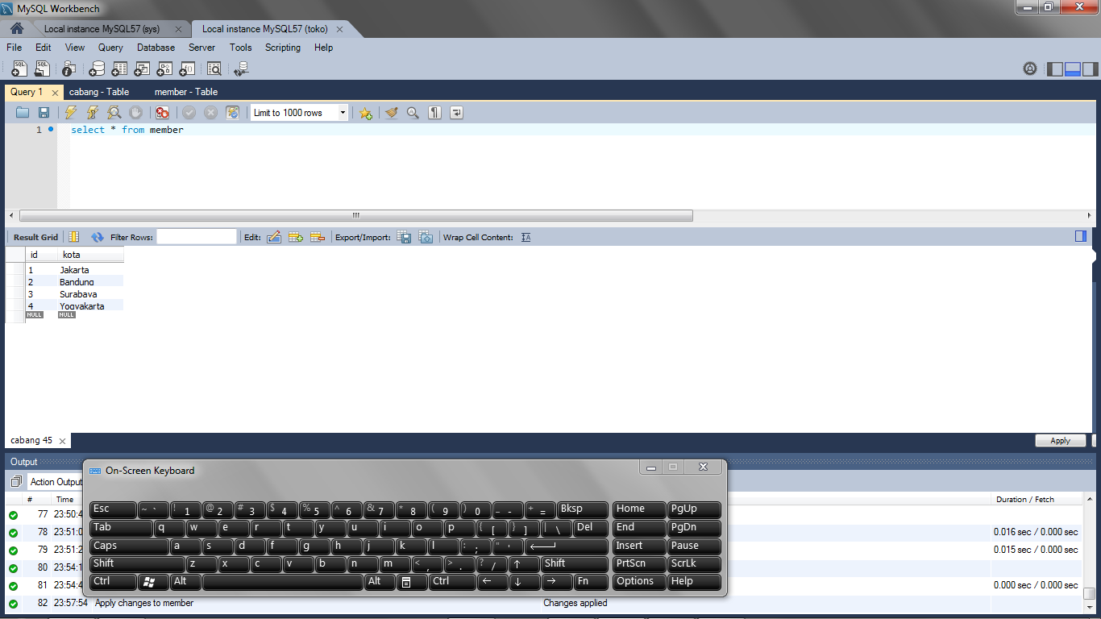
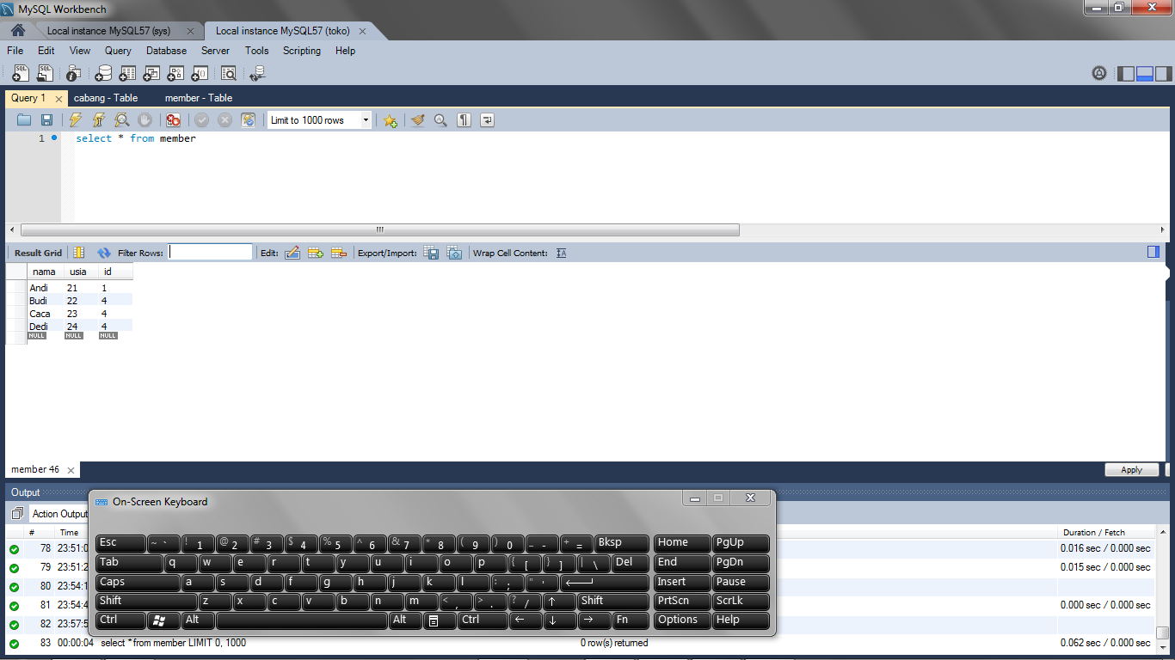
Join Table
Buat 2 tabel dengan 1 kolom yang beririsan,
dalam contoh kali ini yaitu kolom ‘id’
(nama kolom tidak harus sama).
cabang
member
Foreign Key

Slide 48
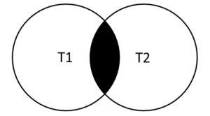
#1 Inner Join
The MySQL INNER JOIN clause matches rows in one table with rows in other tables and allows you to query rows that contain columns from both tables.
The following Venn diagram illustrates how the INNER JOIN clause works. The rows in the result set must appear in both tables: t1 and t2 as shown in the intersection part of two circles.

Slide 49
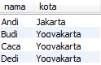
#1 Inner Join
cabang
member
$ SELECT nama, kota FROM member
-> INNER JOIN cabang ON
-> member.id = cabang.id;
$ SELECT nama, kota FROM member
-> JOIN cabang USING (id);

Slide 50
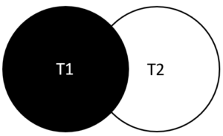
#2 Left Join
The MySQL LEFT JOIN clause allows you to query data from two or more database tables. The following Venn diagram helps you visualize how the LEFT JOIN clause works. The intersection between two circles are rows that match in both tables, and the remaining part of the left circle are rows in the t1 table that do not have any matching row in the t2 table. Hence, all rows in the left table are included in the result set.

Slide 51
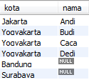
#2 Left Join
cabang
member
$ SELECT kota, nama FROM cabang
-> LEFT JOIN member USING (id);

Slide 52
View
Virtual tabel yang didefinisikan dari query select & sifatnya identik dengan tabel.
View daftar karyawan dengan BB > 60 :
CREATE VIEW jumbo AS
-> SELECT Nama, Berat FROM karyawan
-> WHERE Berat > 60;
Cek daftar tabel:
$ SHOW tables;
$ SHOW FULL tables;
*Akan muncul tabel
(view): jumbo
Hapus view:
$ DROP view jumbo;
Cek data dalam view:
$ SELECT * from jumbo;

Slide 53
View
View daftar member di Yogyakarta:
CREATE VIEW mem_yk AS
-> SELECT nama, kota FROM member
-> JOIN cabang USING (id)
-> WHERE kota = 'Yogyakarta';
Cek daftar tabel:
$ SHOW tables;
$ SHOW FULL tables;
*Akan muncul tabel (view): mem_yk
Hapus view:
$ DROP view mem_yk;

Slide 54
?
How to Work
With MySQL
Hosting

Slide 55
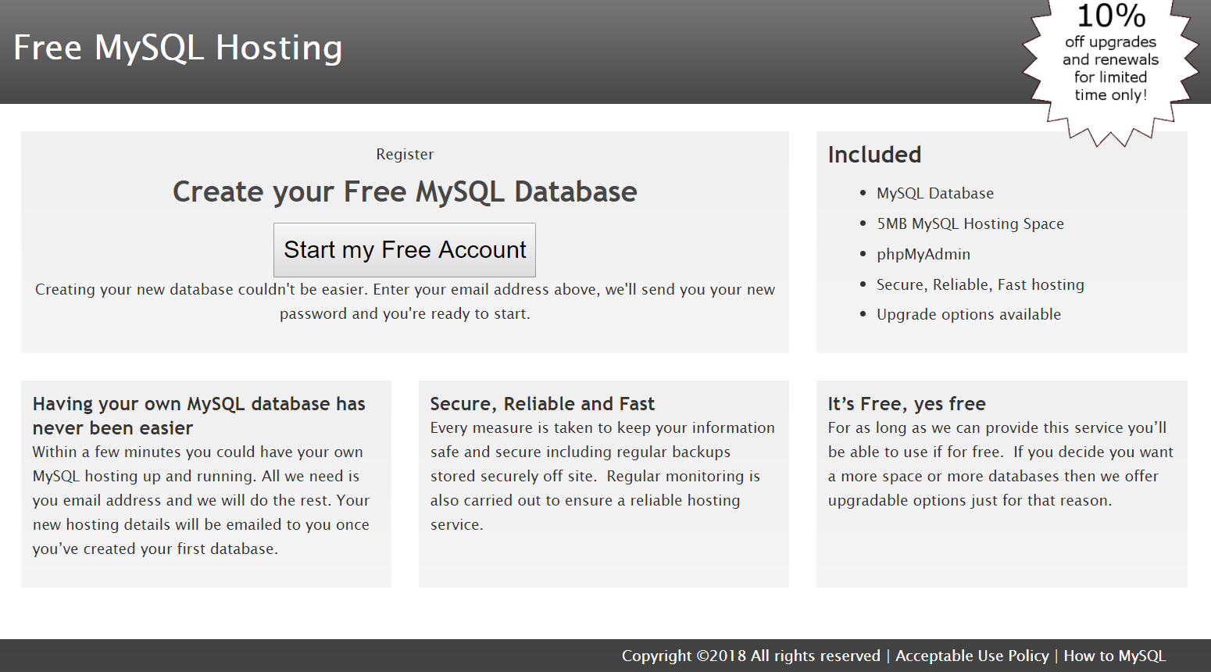
Free MySQL Hosting
freemysqlhosting.net/

Slide 56
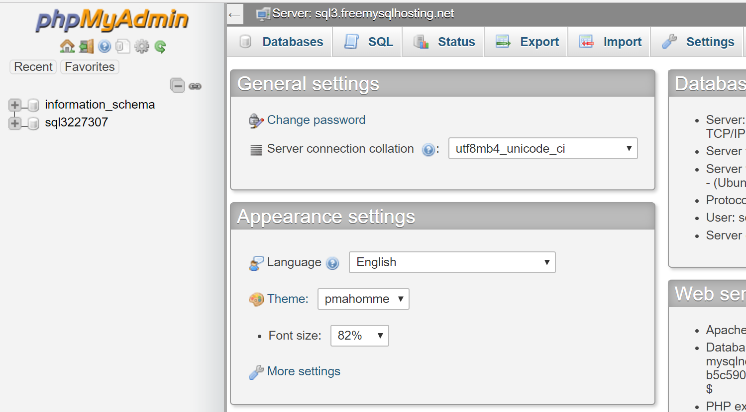
phpMyAdmin
phpmyadmin.co/

Slide 57
Exploration

